Slide 1




My Algebra Interactive Notebook
$$3ab$$
$$2x+3y$$
$$\frac{5xy}{6}$$
Name :
Class :
Term 2 Semester 1
$$y=2x+1$$

Slide 2
Contents
Glossary
Page
Date
Description
2
3

Slide 3
Tasks
24
7
30
Essential Question
Questions
Notes
Summary
4
5

Slide 4
24
7
30
Date
Introduction to Algebra
EQ – What are some of the keywords that I need to know when solving problems using letter symbols?
5

Slide 5
24
7
30
Date
Introduction to Algebra
EQ – What are some of the keywords that I need to know when solving problems using letter symbols?
In algebra we use letters to represent numbers.
5

Slide 6
24
7
30
Date
Introduction to Algebra
EQ – What are some of the keywords that I need to know when solving problems using letter symbols?
In algebra we use letters to represent numbers.
These letters are called variables or pronumerals.
5

Slide 7
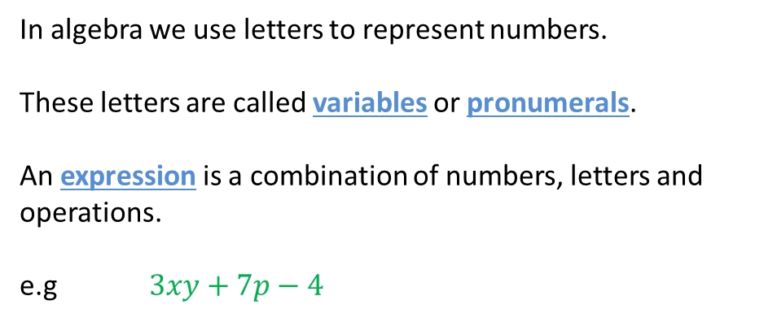
24
7
30
Date
Introduction to Algebra
EQ – What are some of the keywords that I need to know when solving problems using letter symbols?
In algebra we use letters to represent numbers.
These letters are called variables or pronumerals.
An expression is a combination of numbers, letters and operations.
e.g $3xy+7p−4$
5

Slide 8
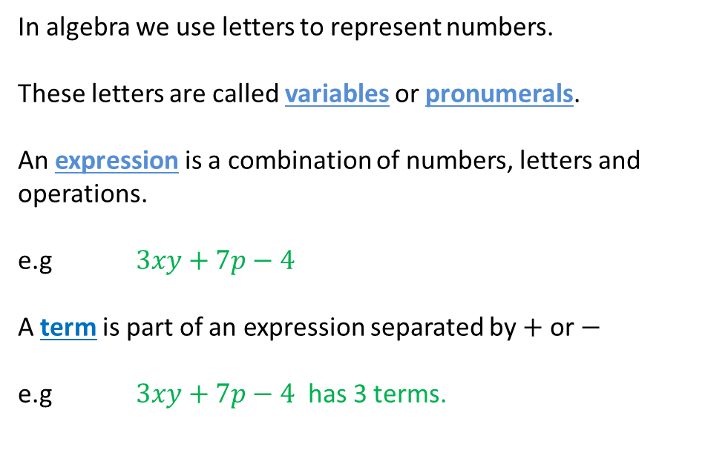
24
7
30
Date
Introduction to Algebra
EQ – What are some of the keywords that I need to know when solving problems using letter symbols?
In algebra we use letters to represent numbers.
These letters are called variables or pronumerals.
An expression is a combination of numbers, letters and operations.
e.g $3xy+7p−4$
A term is part of an expression separated by $+$ or $−$
e.g $3xy+7p−4$ has 3 terms.
5

Slide 9

24
7
30
Date
Introduction to Algebra
EQ – What are some of the keywords that I need to know when solving problems using letter symbols?
In algebra we use letters to represent numbers.
These letters are called variables or pronumerals.
An expression is a combination of numbers, letters and operations.
e.g $3xy+7p−4$
A term is part of an expression separated by $+$ or $−$
e.g $3xy +7p−4$ has 3 terms.
5

Slide 10

24
7
30
Date
Introduction to Algebra
EQ – What are some of the keywords that I need to know when solving problems using letter symbols?
In algebra we use letters to represent numbers.
These letters are called variables or pronumerals.
An expression is a combination of numbers, letters and operations.
e.g $3xy+7p−4$
A term is part of an expression separated by $+$ or $−$
e.g $3xy +7p−4$ has 3 terms.
5

Slide 11
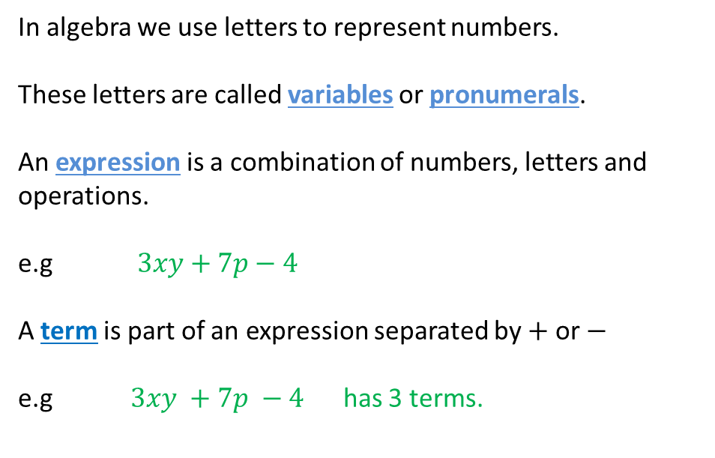
24
7
30
Date
Introduction to Algebra
EQ – What are some of the keywords that I need to know when solving problems using letter symbols?
In algebra we use letters to represent numbers.
These letters are called variables or pronumerals.
An expression is a combination of numbers, letters and operations.
e.g $3xy+7p−4$
A term is part of an expression separated by $+$ or $−$
e.g $3xy +7p −4$ has 3 terms.
5

Slide 12
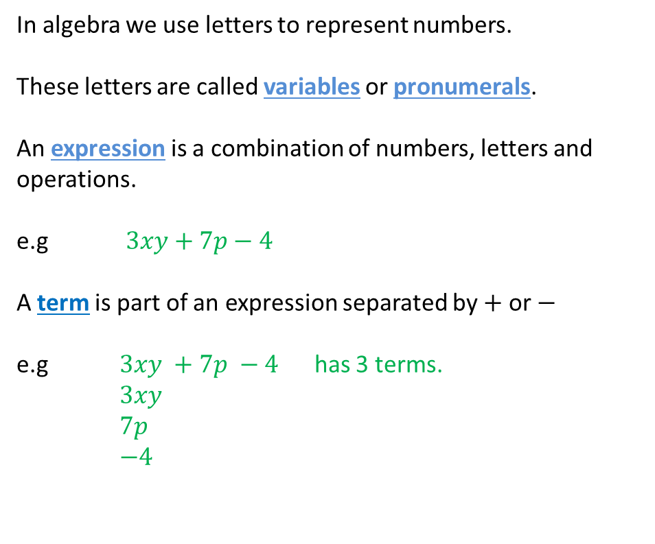
24
7
30
Date
Introduction to Algebra
EQ – What are some of the keywords that I need to know when solving problems using letter symbols?
In algebra we use letters to represent numbers.
These letters are called variables or pronumerals.
An expression is a combination of numbers, letters and operations.
e.g $3xy+7p−4$
A term is part of an expression separated by $+$ or $−$
e.g $3xy +7p −4$ has 3 terms.
$3xy$
$7p$
$−4$
5

Slide 13
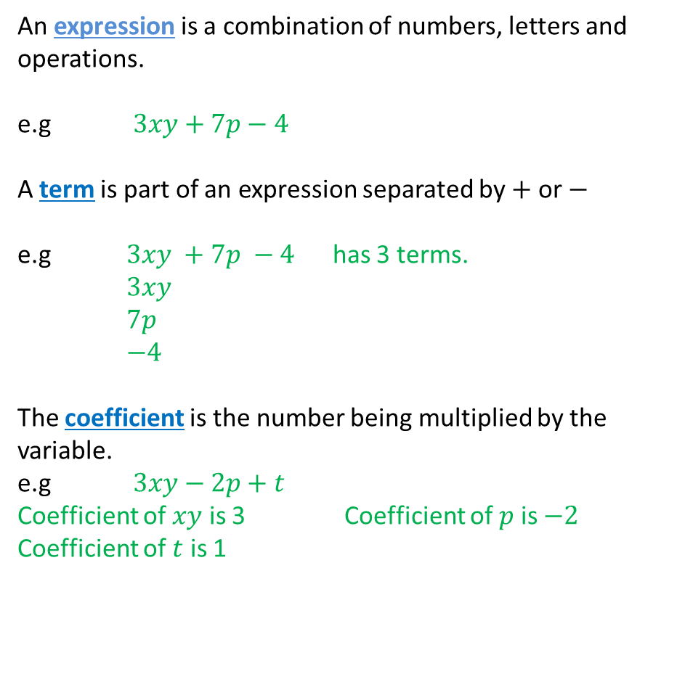
24
7
30
Date
Introduction to Algebra
EQ – What are some of the keywords that I need to know when solving problems using letter symbols?
An expression is a combination of numbers, letters and operations.
e.g $3xy+7p−4$
A term is part of an expression separated by $+$ or $−$
e.g $3xy +7p −4$ has 3 terms.
$3xy$
$7p$
$−4$
The coefficient is the number being multiplied by the variable.
e.g $3xy−2p+t$
Coefficient of $xy$ is 3 Coefficient of $p$ is $−2$
Coefficient of $t$ is 1
5
Notes:
iv

Slide 14
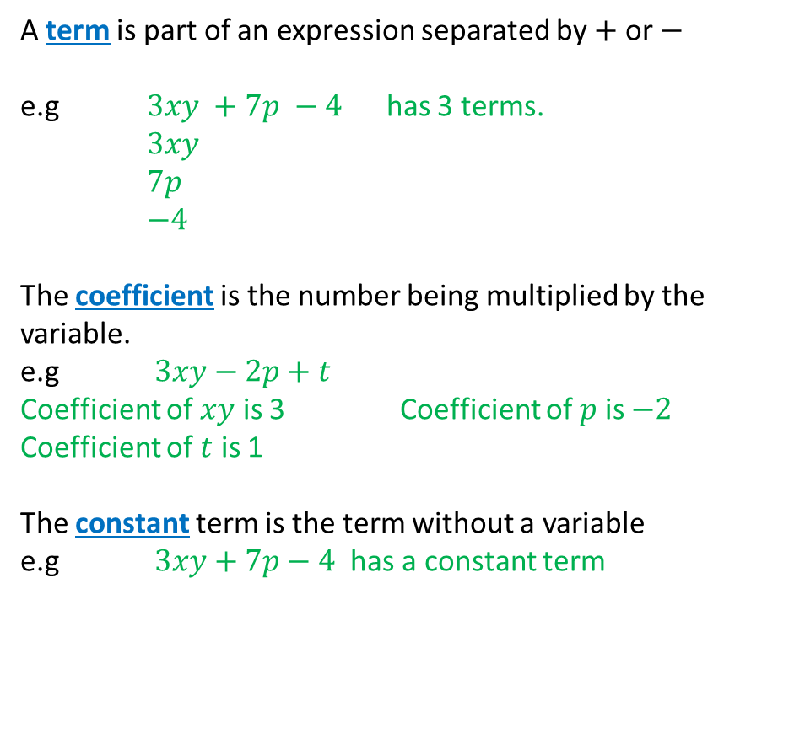
24
7
30
Date
Introduction to Algebra
EQ – What are some of the keywords that I need to know when solving problems using letter symbols?
A term is part of an expression separated by $+$ or $−$
e.g $3xy +7p −4$ has 3 terms.
$3xy$
$7p$
$−4$
The coefficient is the number being multiplied by the variable.
e.g $3xy−2p+t$
Coefficient of $xy$ is 3 Coefficient of $p$ is $−2$
Coefficient of $t$ is 1
The constant term is the term without a variable
e.g $3xy+7p−4$ has a constant term
5
Notes:
iv

Slide 15
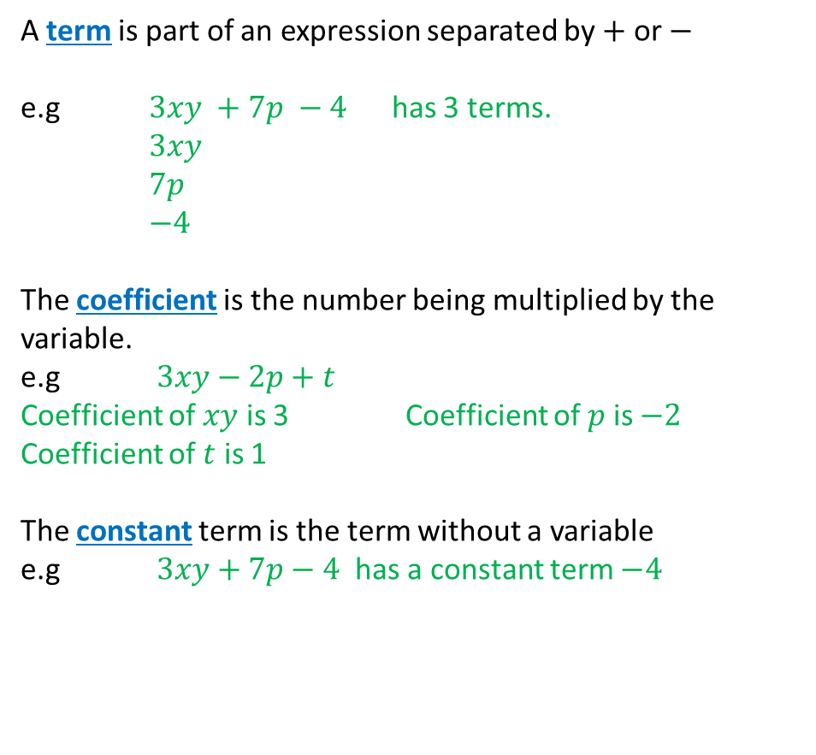
24
7
30
Date
Introduction to Algebra
EQ – What are some of the keywords that I need to know when solving problems using letter symbols?
A term is part of an expression separated by $+$ or $−$
e.g $3xy +7p −4$ has 3 terms.
$3xy$
$7p$
$−4$
The coefficient is the number being multiplied by the variable.
e.g $3xy−2p+t$
Coefficient of $xy$ is 3 Coefficient of $p$ is $−2$
Coefficient of $t$ is 1
The constant term is the term without a variable
e.g $3xy+7p−4$ has a constant term $−4$
5
Notes:
iv

Slide 16
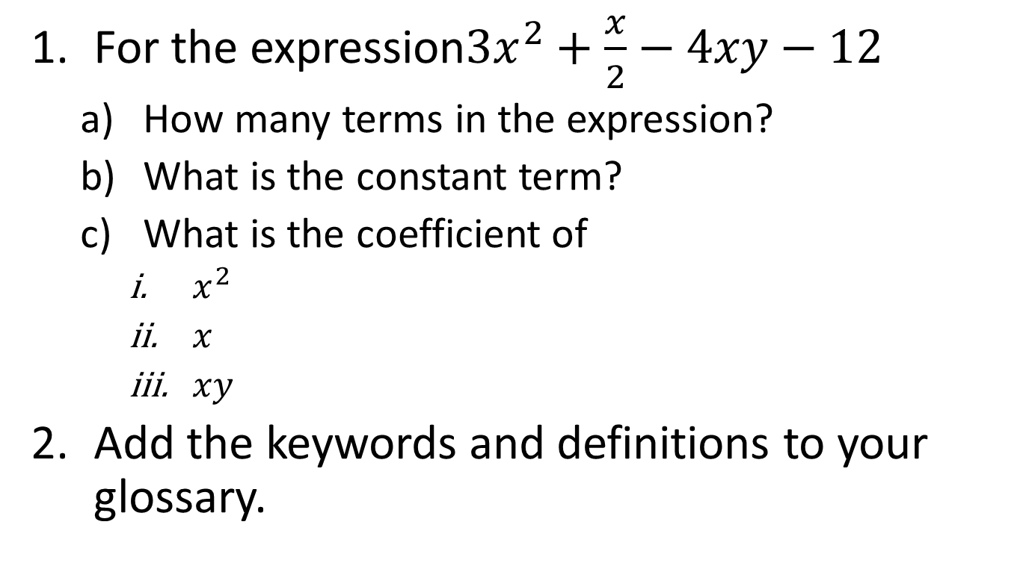
Task
For the expression
How many terms in the expression?
What is the constant term?
What is the coefficient of
Add the keywords and definitions to your glossary.

Slide 17
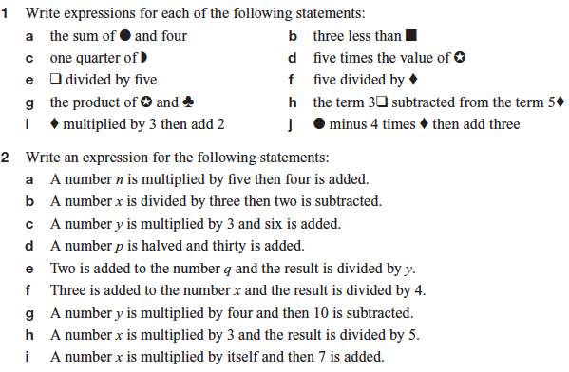
Task

Slide 18
Fill in the questions

Slide 19
Notes Review
24, 7 ,30
Date
Title
Essential question
Notes complete
Notes complete with colour and diagrams
Questions completed
Contents page filled in
Formula page filled in

Slide 20
Homework
Review your notes and write a summary answering the essential question.

